Slide 1

South West MSK Rapid Access Clinics
Primary Care Webinar
March 28, 2019

Slide 2
Objectives of today’s presentation
1. Status update:
  Process changes
  Onboarding requirements
  Launch dates
2. Answer your questions
3. Discuss our asks
See the Appendices if you would like a refresher on the MSK Program.

Slide 3
What you need to know

Slide 4
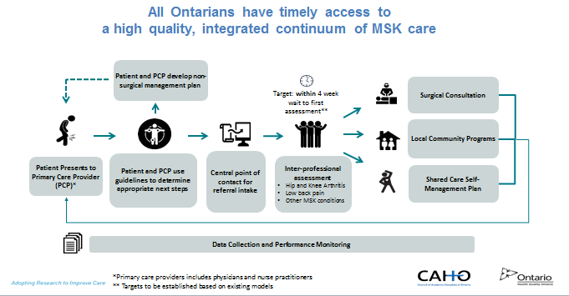
The Provincial Musculoskeletal (MSK) Rapid Access Clinics Program

Slide 5



The first two pathways to be implemented are:
  Hip and knee arthritis pathway:
    For patients: 1) presenting with moderate to severe arthritis, 2) needing a second opinion on prior arthroplasty
    Excludes: urgent cases, ligamentous injuries and meniscal pathology
  Low back pain pathway:
    For patients presenting with: 1) persistent Low Back Pain and/or related symptoms (e.g., sciatica, claudication) 6 weeks to 12 months post onset; 2) unmanaged, recurrent episodic low back pain symptoms (LBPS)
    Excludes: patient with red flags, unmanaged, established chronic multi-site pain disorder and/ or unmanaged established narcotic dependency, active low-back pain related WSIB or MVA claim, active low back pain legal claim, pregnant/post-partum (<12 months) or <18 years of age
40% of patients do not require a consultation with a surgeon
Primary Care
Specialist
Advanced Practice PROVIDERS
Only 7% of people referred to the low back pain management pathway need surgery
Over time, proven pathways for managing other MSK conditions will be integrated into the Rapid Access Clinics

Slide 6
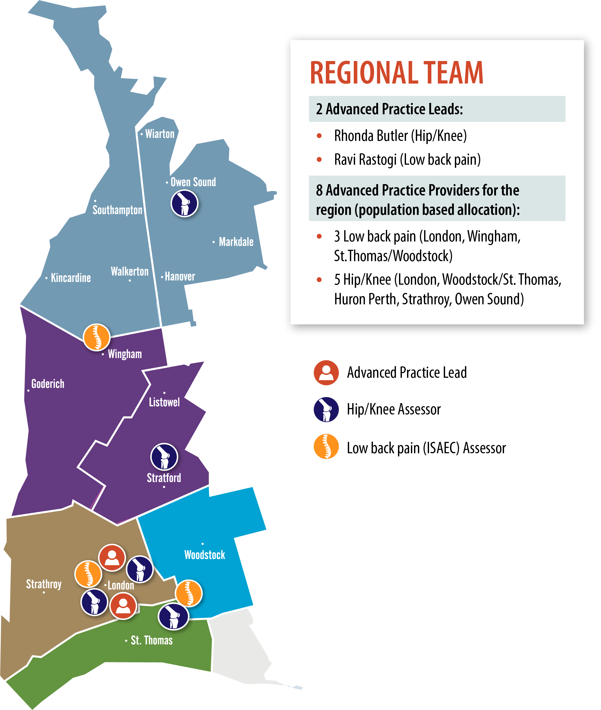
Location of Assessors
** Advanced Practice Leads provide additional assessment supports across the region where needed
Notes:
Faadia: I suggest using this slide instead of slide 6

Slide 7
Process Changes:
Activity | Current Practice | Future Practice | Comments
1. Submit Referral Forms for patients with Low Back Pain or Osteoarthritis | Primary Care sends to surgeon offices | Central Intake
2. Notify patient of appointment with RAC | N/A | Central Intake | Primary Care will be notified of the appointment date, FYI.
3. Completion of patient assessment | Surgeon Office | APP/APL | An Outcome Summary and Recommendations will be sent to Primary Care and will include shared care self-management plan for the patient.
4. Referral to Surgeon | Primary Care | Central Intake/ APP/APL | Primary Care will be notified.
5. Notify patient of consultation with Surgeon. | Primary Care | Hip/Knee: Primary Care Low Back Pain: APL | Low Back Pain APL will have access to surgeon schedules and will book appointment at same time as his assessment. Hip & Knee program will follow current practice.
APL = Advanced Practice Leader
APP = Advanced Practice Provider
* Refer to each program’s exceptions where Primary Care continues to send referrals direct to surgeon offices

Slide 8

Onboard Requirements:
Hip and Knee:
Receive notification from Partnering For Quality to download referral forms to your EMR.
Low Back Pain:
Complete the registration http://www.isaec.org/isaec-registration.html for ISAEC online learning. This is a prerequisite to receiving the Low Back Pain referral form.
Upon completion of the registration, you will have access to an online video and quiz. Duration is approx. 20 minutes.
Upon successful completion of the quiz, you will receive notification to download the Low Back Pain Referral form via the ISAEC Operations staff.

Slide 9

Important Information
Primary Care Offices will be notified of all:
  invitations to waitlisted patients to receive an assessment prior to a call being made to your patient;
  patient appointment dates;
  Patient assessment outcomes, including referrals to surgeons.
Wait-listed, low back pain and osteoarthritis patients within inclusion criteria will be offered assessments prior to new referrals.
The four week turnaround from time of referral to assessment will not be met until waitlisted patients are assessed. Please let your new referrals know.
Rapid Access Clinics in London, St. Thomas, Woodstock and Wingham (Low Back Pain) will be ready by launch date. The Hip and Knee Rapid Access Clinics in:
  Owen Sound will be live by April 30, 2019.
  Stratford and Strathroy will be live by June 15, 2019
Initially, as Low Back Pain patients on waitlists are seen, it is anticipated that the assessments will be conducted in London to streamline the patient’s visit with a Spine surgeon.

Slide 10

Key Dates:
February 28, 2019: Referral forms will be available through a) ISAEC Operations, once the ISAEC (Low Back Pain) module is completed and b) the Hip and Knee referral form will be available online at http://www.swpca.ca/ under the EMR resources tab.
March 29, 2019: App. 50 wait listed patients experiencing low back pain or osteoarthritis will have been assessed.
Monday, April 15, 2019:
  All Primary Care Providers use new referral forms and submit to Central Intake.
  Surgeon Offices may return referrals to Primary Care that should be redirected to Central Intake.
June 30, 2019: Target date for completion of 20 minute, ISAEC learning module by Primary Care Providers.

Slide 12
What’s Next For You, Our Primary Care Partners
1. Go to http://www.isaec.org/isaec-registration.html to submit your ISAEC registration and complete the 20 minute, online training module.
2. On April 15, download the Hip and Knee referral form, and start using the form. Do same with the Low Back Pain referral form as soon as the training module is complete.
3. Advise your patients that waitlisted patients are being assessed prior to new referrals.
The South West Rapid Access Clinics will advise when all waitlisted patients have been
seen and the standard, four-week turnaround for assessments will be met
4. Provide feedback on your experiences with the onboarding process and the program to:
    Your Primary Care Lead
    MSK Primary Care Champion: Tatiana.Jevremovic@lhsc.on.ca
    Advanced Practice Leaders:
    Hip and Knee: Rhonda.Butler@lhsc.on.ca
    Low Back Pain: Ravi.Rastogi@lhsc.on.ca
    Central Intake: MSK_CentralIntake@lhsc.on.ca
5. A patient information brochure is in development.

Slide 13
Appendices: Overview of the MSK Strategy

Slide 14
Summary of South West Musculoskeletal Rapid Access Clinics
Roles and Responsibilities
Attached is a summary by position of:
1. Advanced Practice Leader(s)
2. Central Intake
3. ISAEC Operations
4. Primary Care Provider
5. Primary Care Provider Leads
6. Partnering for Quality
7. South West LHIN/Primary Care Champion
(Double click the icon and the
document will appear at the
bottom of your options bar)

Slide 15
A strategy for patients with MSK conditions is the first priority area…
Many MSK patients experience frustration waiting for services that have the longest waits in the province* and areas where family doctors need the most support to manage their patients**
Patients with back pain often wait for unnecessary MRIs, and then wait for unnecessary surgical consultation
  It is estimated that 40-50% of orthopaedic MRIs currently ordered in Ontario may be inappropriate
Wait lists for hip and knee surgeons are poorly organized. Well known surgeons have long wait lists and many referrals while new surgeons have fewer referrals and shorter wait times.
While patients with MSK pain are waiting for unnecessary MRIs and potentially unnecessary consultation, they are at risk for opioid addiction.
*Longest waits for surgery are for MSK conditions
**Ontario College of Family Physicians has noted MSK as a priority area for greater support for primary care providers
What is MSK?
MSK affects the muscles, ligaments, and
tendons, and bones

Slide 16
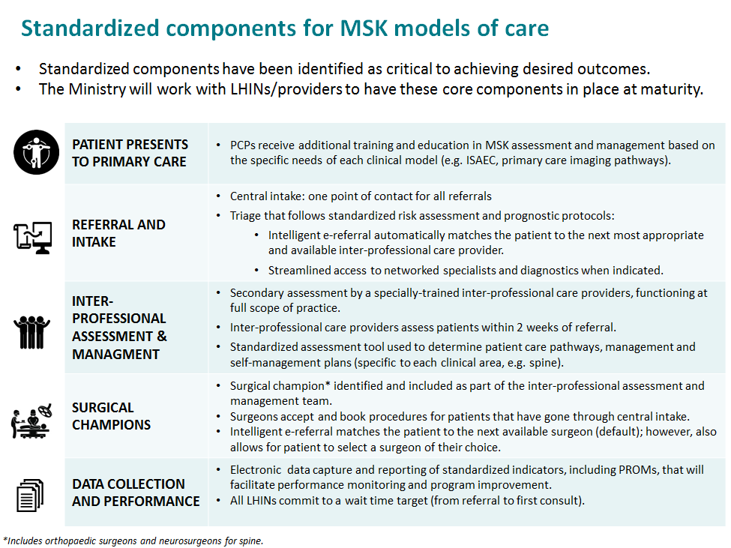

Slide 17

The vision for MSK care
Primary Care will be able to support their patients through an accessible consistent patient care pathway and improved access to specialty care
Specialists receive more appropriate referrals which allow for more predictable practice and improved wait list management.
Ontario’s health system will become more sustainable, with improved access to appropriate and high quality care.
All Ontarians have timely access to high quality, integrated MSK Care through:
Proven models of care
A team approach, Shared care
Improved value
Patient choice
Selective referral to surgeons
Integration through community resources and linkages
E-tracking/referral management
Notes:
Dr. Gollish

Slide 18






The need to address access to care for patients with MSK conditions is growing
Evidence for Action:
Prevalence
1 in 3 adults affected by musculoskeletal (MSK) diseases (e.g. arthritis, repetitive strain injuries), which will only grow as the population ages
Utilization
3.1M Ontarians made 8M outpatient visits associated with MSK in 13/14 (5.6M were primary care visits, 560K ED visits)
At least 37% of MRIs in the province are ordered for MSK conditions
Surgical utilization
MSK surgeries account for 15% and represent the lowest % completed within target, of surgical procedures in ON
Volumes steadily increasing since 12/13: hip replacement: 5.1%/year, knee replacement: 3.3%/year
Opioid dependency
Timely access to appropriate MSK services reduces the incidence of unnecessary opioid prescriptions. Any opioid prescription carries with it a risk of opioid dependence.
Clinical appropriateness
Evidence for sustained reductions in inappropriate utilization (e.g. low back pain pilot in three sites saw $500K/year in costs avoided in reduced imaging)
Aging population will continue to require procedures that are clinically appropriate (e.g. hip/knee replacement)
Notes:
Dr. Gollish
Speaks to the need from another perspective
Primary care providers and their patients are frustrated with access to specialist care
Limited patient education and availability of conservative management to support patients with MSK conditions
Patient care delays secondary to:
Surgeons are managing both surgical and non-surgical care for patients with hip and knee OA
Patients receive limited support and guidance while waiting for specialist consultation

Slide 19
Methods of APP Competency Assessment*
Workplace Observation (s)
Case based Presentations
Radiology/Pharmacology/Pathology management
Written Response
Assessed either by orthopaedic surgeon or experienced advanced practice practitioner (APP) who has completed competency requirements
Assessed by competent APP appointed as an assessor
Performance Appraisal
Formal education/learning modules where available
Radiology interpretation case series
Conducted by orthopaedic surgeon
Documentation Audit
Conducted by competent APP appointed as an assessor
Professional Practice Portfolio
Record of all education sessions/in-services/mentoring
Use of electronic clinical log
Formal Qualification
Formal, university-based coursework for targeted learning (e.g. diagnostic imaging, pharmacology, diabetes )
*Slide adapted from
P. Harding,
Competency Webinar
for Ontario.
August 15, 2018
19
Notes:
Susan Robarts
Part 2 of the Workbook provides the details for the Assessment Tools including ‘how to use’ sections for each tool
Incorporate the Performance Appraisal tool into the APP’s annual performance review (1 page, Y/N, mapped to Standard)

Slide 20
What it is / What it is not
The Competency Standard involves:
Identification of the gap specific to the scope of practice
Promoting self-directed learning
Integrating and applying new knowledge, skills, and abilities
Demonstrating competence
It is not only about technical competence or doing a task
It is not about reaching expert level in every element
It is not a one-time event
Notes:
Susan Robarts
Here’s what you need to know about it:
Some elements require awareness only; others require more advanced knowledge and skills
Intended as a guide
For APP: Transparent, Aspirational, Empowering. Opportunity to show what you know and work to the full potential of the role
For surgeons/clinical leads: Evaluate performance more effectively, identify gaps with more efficiency and customize training
Dynamic ongoing process

Slide 21
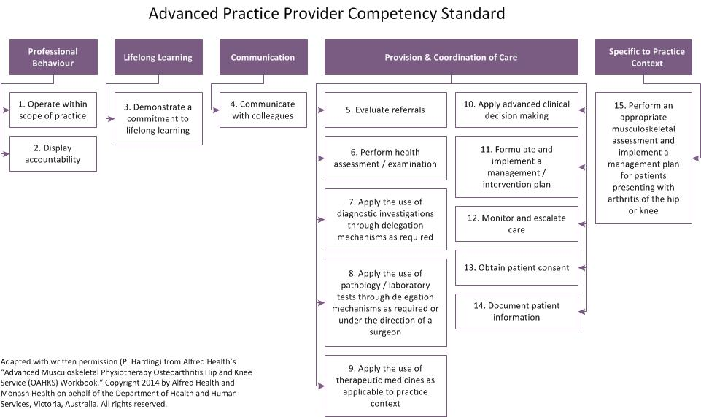
21
Notes:
Susan Robarts
Here is the Standard adopted from Australia
Describe in broad strokes…
Contains clearly defined performance criteria mapped to competency standards – describe an independent performer in action
Robust, Comprehensive
Transparent
Built-in flexibility for:
Site-specific practices / needs
APP learning needs / experience
Refer to the webinar presented by Dr. Paula Harding – August 15th.

Slide 22
Roles and Responsibilities
Surgeon Lead
Is familiar with the Competency Standard (see pages 1-15 Competency Workbook, Part 1)
Provides professional guidance
Ensures there is appropriate time allocated to discuss clinical cases and ongoing supervision
Discusses the trainee’s progress with the APP Clinical Lead on a regular basis
Determines with the trainee when they are ready to progress
Participates in the competency assessment process
Trainee
Takes ownership of their progress
Identifies learning gaps and a plan to address*
Is responsible for planning their timetable per the Orientation Manual and recommended activities
Arranges appropriate support required to achieve sign off
*Learning and Assessment Plan Template – Competency Workbook Part 1
22
Notes:
Susan Robarts
Here’s your role in APP training and assessment: guidance, coaching, sign off
get familiar with pages 1-15 that describe an independent performer in action – read the cues and the criteria. Contextualize it to your setting. Ignore what’s not relevant.
Trainee – completes a comprehensive Learning and Assessment Plan from the Competency Workbook - mapped to the Competency Standard

Slide 23
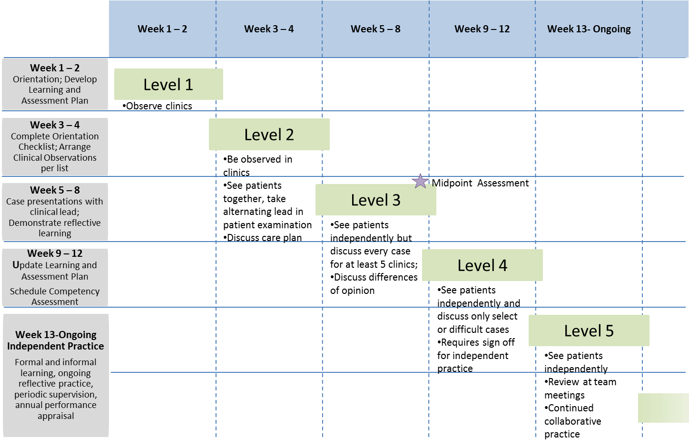
3-month Hip & Knee Practice Development Timeline
Orientation Manual, pg. 6
23
Notes:
Susan Robarts
APPs undergo an assessment at midpoint, re-visit learning needs assessment
Goal is to achieve independence by week 13
This is a guideline for timing, very flexible

Slide 24
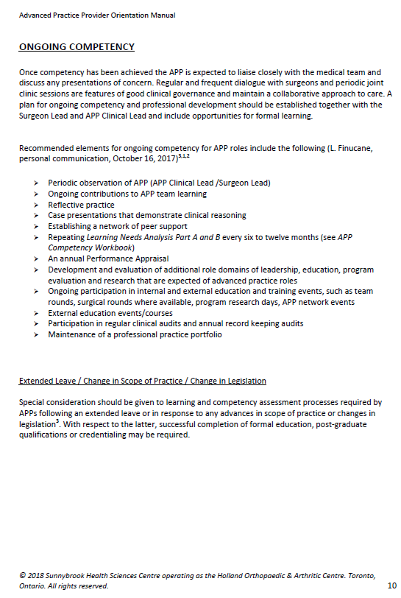
Ongoing Competency
APPs should work alongside surgeons in clinic at regular intervals
Surgeons should participate in APP annual performance appraisal
Surgeons should advocate for APP learning opportunities
24
Notes:
Described in detail in the Orientation manual
APPs should also be observed by Clinical lead where available, if not, reach out for qualified support
Surgeons should advocate for time out of clinic for APPs to complete learning activities
Surgeons should contribute to APP team learning – Jeff can speak to our strategies

Slide 25
Training the Practice Leader and APPs in Low Back Pain
Online
  Introduction to the ISAEC Model
  Physical Medicine and Rehabilitation, Chronic Pain Management, and Spondyloarthritis
  Motivational Interviewing, Inter-Professional Collaboration and the Primary Care Perspective
  Surgical Training
    History/Physical/Patterns
    Protocols, Treatment Plans and Consult Note Expectations
    Understanding Surgical Appropriateness
  Training Wrap Up - Review, Case Discussions, ISAEC CMS Training and Final Assessment
In-person training with the spine surgeon
  PL – intensive 3-months
  APP – 2 days/week for 4 weeks
Formal Evaluation
  The surgeon sponsor formally evaluates the PL for required competencies and skill sets to assess and manage surgical patients using a standardized evaluation tool.
  The PL and Surgeon will formally evaluate the APPs using a standardized evaluation tool
Notes:
Explain the role of the surgeon in APP onboarding/training , i.e. ongoing expectations of local surgeons i.e. attend clinics/rounds/case discussions etc.
The APP and PL Training: Support by local surgeons
APP Training (8 days of Sx triage training)
Self-directed on-line training component
On-line case based quizzes and a final exam
Workplace Observation : PL developing APP training for on-site component using a standardized training outline, include OSCE type Case based Presentations
Working through cases
Exelicare CMS system training….expectation of consult note , patterns of pain, coordinate surgical triage .. Training for ISAEC model of care.
Ending with a Performance Appraisal by the surgeon sponsor
Ongoing evaluation of performance and quality (chart audits, site visits)
Surgeon Lead Role in Training
Is familiar with the Training Outline
Provides professional guidance
Ensures there is appropriate time allocated to discuss clinical cases and ongoing supervision
Discusses the APP’s progress with the Practice Leader
Determines with the trainee when they are ready to progress
Participates in the competency evaluation process
Trainee role in training
Takes ownership of their progress
Identifies learning gaps and a plan to address
Is responsible for planning their timetable per the Training Outline and recommended activities
Arranges appropriate support required to achieve sign off

Slide 26
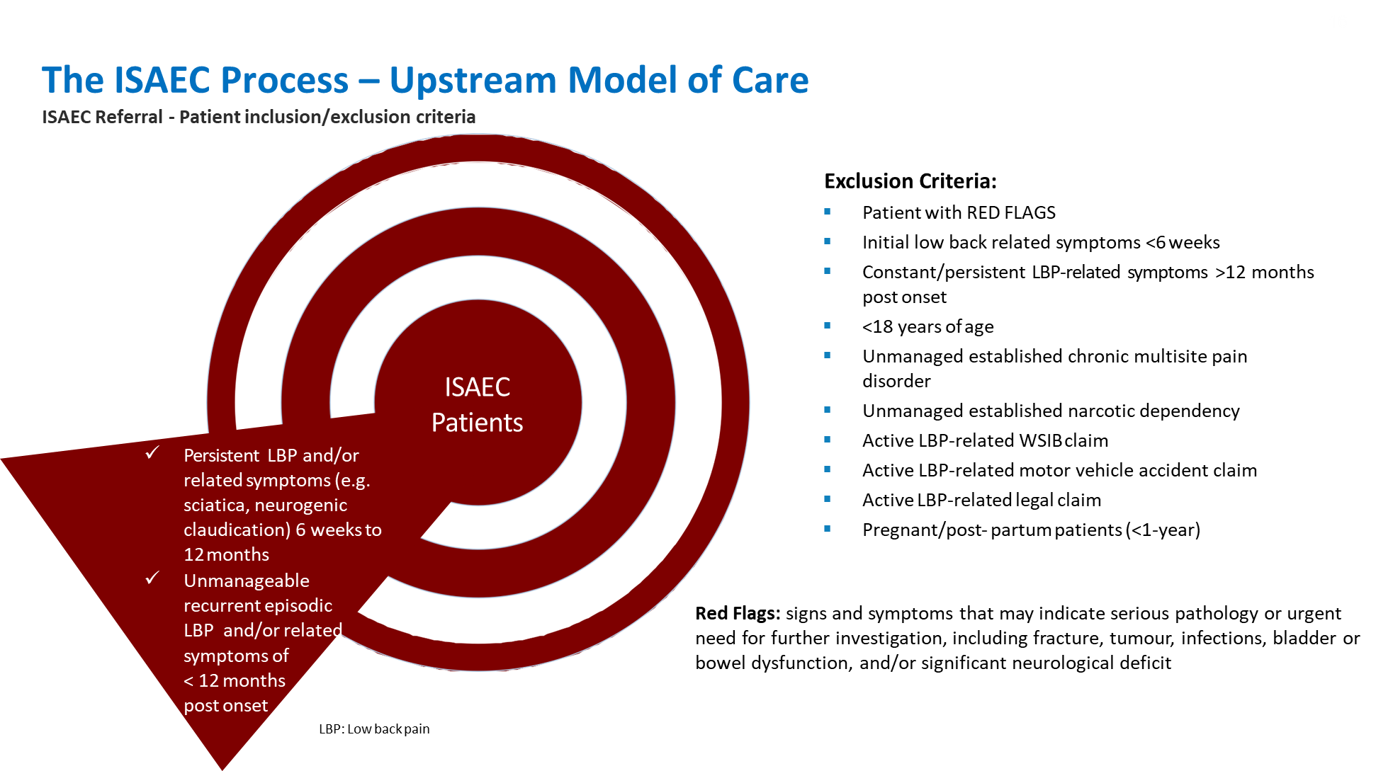

Slide 27
Key Benefits to Surgeons
See patients that are appropriate to sub-specialty interests
Receive full history and physical examination, with outcome measurement
Receive information as to patient’s readiness for surgery
Focused assessment with appropriate work up completed
Avoids surgical delays/cancellations with health issues identified earlier
Team approach maximizes efficient use of surgeon’s time
Notes:
How has program been beneficial for Dr. Rampersaud’s patients and helped him to manage his practice

Slide 28
ISAEC pilot* successes to-date
Since November 2012, ISAEC has consistently demonstrated positive results in terms of delivering
Accessible, evidenced-based, patient-centred LBP services. Key achievements include:
  Average wait time for initial assessment = 12 days, and surgical assessment <6 weeks;
  99% patient satisfaction and substantial increase in provider satisfaction;
  ISAEC patients show an average 10 point improvement in ODI score;
  Significant reduction in chronicity risk six months following treatment in the Project;
  Greater than 96% of patients referred for consultation with a surgeon were surgically appropriate;
  Less than 4% proceed with specialist intervention;
  Significant built-in knowledge transfer to participating PCPs as PCPs reported a two-fold increase in their
  confidence in treating/ managing LBP; and,
  Sustained annual cost-savings of greater than $500,000 from the reduction in participating PCPs spine-
  related imaging referral and utilization with annual cost avoidance per PCP of $3150 and $4175 in year 1 and 2 respectively.
*ISAEC pilot sites are in Toronto, Hamilton and Thunder Bay
Data from ISAEC research data base (UHN-YRR) and PMO-UHN
28
Notes:
This is a summary of some of the successes of the ISAEC pilot.
The pilot mandated 2 weeks from referral to assessment with an APP and was able to achieve a 12 day wait on average. This data is for almost 7000 patients. For a surgical assessment the wait time was under 6 weeks.
And so overall a patient waited for under 2 months where as before they would have waited for sometimes up to 1 year to see a spine specialist.
There was a high level of satisfaction for both patients and providers. Patients were satisfied with the services they received and didn’t insist on getting an MRI or to see a surgeon. They received the information and care that they needed to manage their condition.
The program also showed a good return on investment with regards to cost avoidance predominantly from decrease in primary care MRI use and showed system savings.
This model of care was able to demonstrate the triple aim of value based care -better care, health, and cost- that lead to an investment to spread this model of care across the province.

Slide 29
RAC for LBP Rollout – Summary
What it is
What it is not
Proven upstream shared-care model of care designed around patients, and focuses on their relationship with PCPs for management and mitigation of chronicity of LBP.
Serves patients with wide variety of non-emergent lumbar diagnoses and presentations or those with recurrent episodic LBP < 1 year of duration.
Addresses issues ranging from most non-urgent disc conditions, spinal stenosis, and axial / non-specific back pain.
Rereferring the intended cohort of patients to the RAC for LBP will decrease the number of people on the surgeons’ consultation wait list who would ultimately be determined to not be surgical candidates and allow quicker direct wait 1 access.
Not designed as a surgical referral management program. To date, approximately 15% of LBP patients referred through the pathway progress to a surgical consultation assessment by a Practise Leader, 50% of this 15% go on to see the surgeon (at the same or subsequent visit) and about half of these patients end-up having surgery (i.e. 3.8% of all ISAEC PCP referrals)
Not designed to address every LBP related problem including all chronic low back conditions, and MVA and WSIB patients.
This rollout is intended to create an infrastructure that will enable future growth and innovation both provincially and regionally with the vision of the RACs to progressively provide a broader scope of services.
Notes:
Summary Slide

